Slide 1
xCampus - Final Update
Mark Gallant, pavle boraniev, kazuma sato

Slide 2
Introduction
Description
Features
Problems
Solutions
Demo

Slide 3
Our team…
Kazuma sato – backend & Database
Mark Gallant – Backend & Services
Pavle Boraniev – Mobile app
Our product…
xCampus - full stack application
- Aws api gateway
- Android Application
- RDS Database
- AWS webhosting

Slide 4
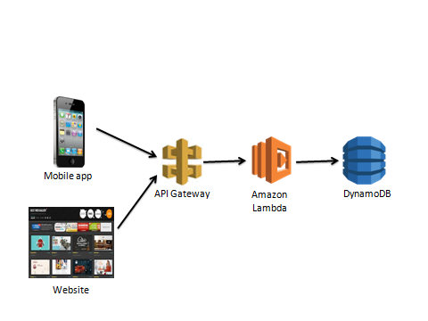
REST
URL based resource management
Structured API gateway (using node)
All data is available through endpoints
Computation is largely client side

Slide 5

Authentication
AWS Cognito
Client certificate requires validation to access various resources
API handles incoming user data to provide appropriate access token

Slide 6
User friendly design
Original designs were cluttered & non-functional
Reduced our use-cases

Slide 7
Specific problems
Group disorganization
Scope overload
Weak documentation

Slide 8
General solutions
Cleaned up some documentation
Lots of reading
Reduced use cases
Took initiative to inquire about progress

Slide 9
Product Demo

Slide 10
Conclusion
Was it a success?
What was the most valuable thing we took?
Are we left satisfied?
Comments on capstone

